Slide 1
Decision Tree and Ensemble Learning

Slide 2

Agenda
Decision Tree
What
Why and Why Not
How:
Scikit-Learn
Entropy vs Gini
Overfitting & Hyperparameter Tuning
Ensemble Learning
What
Bagging
Boosting
Why
Bias vs Variance
How:
Scikit Learn
XGBoost

Slide 3

Decision Tree is a Type of Supervised Learning Algorithm
It works for both categorical and continuous input and output variables
Supports both classification and regression
Split the population or sample into two or more homogeneous sets

Slide 4
Decision Tree is intuitive but Sensitive
Pros:
Generate rules that are readable and interpretable
Prediction runs in constant time
Easy to use, versatile and powerful
Cons:
Sensitive to training set rotation
Sensitive to small variations

Slide 5
How: Scikit learn Example
Depth-0
Node
Scikit-learn uses CART
May not work as intended if all features are categorial
Depth -1
–(49/54) log₂ (49/54) – (5/54) log₂ (5/54) ≈ 0.445
Depth -2
1 – (0/54)² – (49/54)² – (5/54)² ≈ 0.168

Slide 6

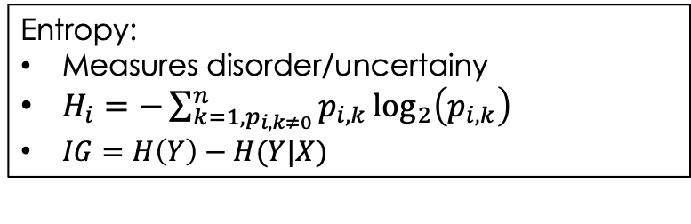
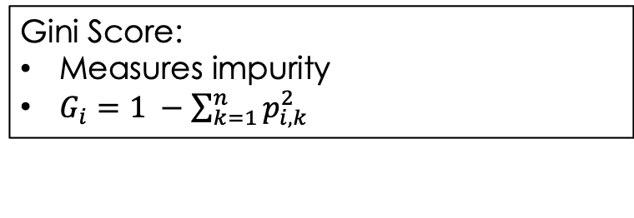
Decision tree Splits on Impurity or Information Gain
$p_{i, k}=\frac{\# of sample in class k in node i}{Total samples in node i}$
Using either one will lead to similar trees
Gini impurity is slightly faster to compute and default on scikit-learn
See here for more details
Gini Score:
Measures impurity
$G_{i}=1 −\sum_{k=1}^{n}{p_{i, k}^{2}}$
Entropy:
Measures disorder/uncertainy
$H_{i}=−\sum_{k=1, p_{i, k≠0}}^{n}{p_{i,k}}\log_{2}\left(p_{i,k}\right)$
$IG=H\left(Y\right)−H(Y|X)$

Slide 7
Reduce Depth of the tree to Avoid Overfitting
Decision Trees make very few assumptions about the training data (versatile but wild)
The tree structure could adapt itself to fit each and every point in the training data – overfitting
At least restrict the maximum depth of the Decision Tree (max_depth)
min_samples_split: the minimum number of samples a node must have before it can be split
min_samples_leaf: the minimum number of samples a leaf node must have
min_weight_fraction_leaf: same as min_samples_leaf but expressed as a fraction of the total number of weighted instances
max_leaf_nodes: the maximum number of leaf nodes
max_features: the maximum number of features that are evaluated for splitting at each node
Increasing min_* hyperparameters or reducing max_* hyperparameters will regularize the model
Cross-validation or grid search

Slide 8
Decision Tree Regression
Bias vs Variance

Slide 9
Ensemble Learning: Most Popular ML Method
Weak learner: learners which does only slightly better than random guessing
Strong learner: achieving high accuracy/precision
Bagging: bootstrap aggregating
Random Forests
Boosting: train predictors sequentially, each trying to correct its predecessor
AdaBoost: Adaptive Boosting
Gradient Boosting

Slide 10
Bias vs Variance
Underfitting: a model unable to capture the underlying pattern of the data
Overfitting: a model captures the noise along with the underlying pattern in data

Slide 11
Bagging and Random Forests
Train one weak learner per each (or random few) features
Majority vote (hard voting) or average of class probability (soft voting) for prediction
Efficient if all classifiers are perfectly independent, making uncorrelated errors
Ensemble methods work best when the predictors are as independent from one another as possible.
One way to get diverse classifiers is to train them using very different algorithms
If weak learner is decision tree, the ensemble is called random forests.
Random forests scales very well and hence is popular

Slide 12
Boosting: State-of-the-art
AdaBoost
Gradient Boost

Slide 13
Pruning and Early Stopping
Pruning: If decision tree overfits, we remove unnecessary nodes (leaves).
If the purity/information improvement it provides is not statistically significant
Very few use pruning anymore
Because ensembles with early stopping based on CV are much easier

